Slide 1

ABP Studio
The Missing Tool for .NET Developers

Slide 2

Agenda
What is ABP Studio? Why We’ve Built it?
Demo
Installation & Overview
Basics: Creating solutions / Using ABP & .NET CLI commands
Building modular & complex applications
Developing, running and monitoring distributed dystems
Working with Kubernetes
Working with ABP Suite
.NET Aspire?
Road Map
Licensing
Next ABP Studio Events

Slide 3
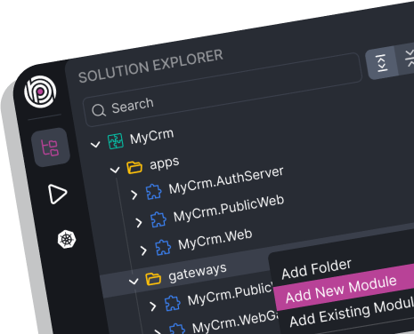
ABP Studio: What it is?
A cross-platform desktop application for ABP developers
A tool you use daily to simplify or automate your non-coding activities
It is not a coding IDE (e.g. Visual Studio)

Slide 4
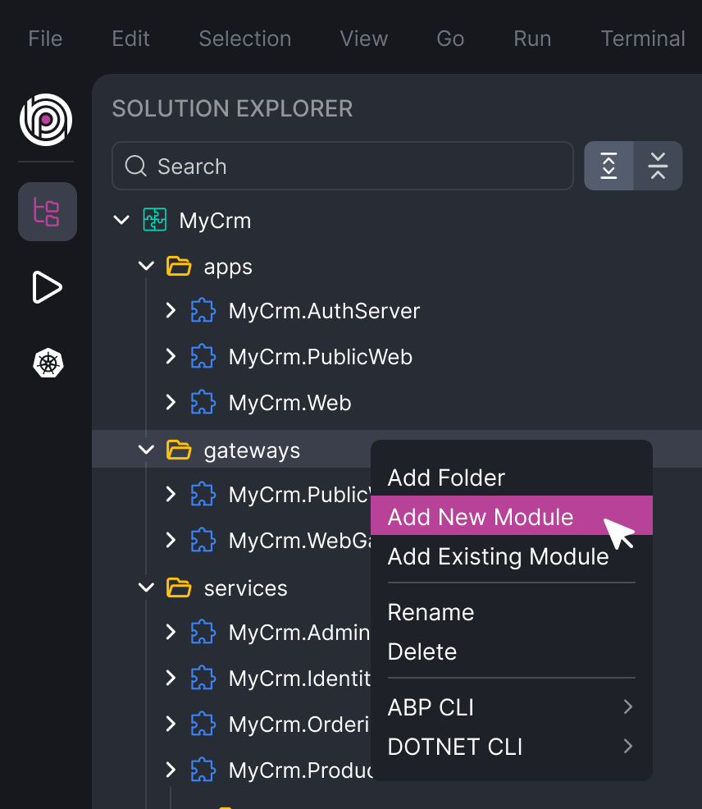
ABP Studio: Why?
A single wiew of a system consists of multiple .NET solutions
Architecting complex software solutions
Modular monoliths
Microservice / distributed systems
Building & managing multi-package or layered modules
Install, uninstall and explore external modules

Slide 5
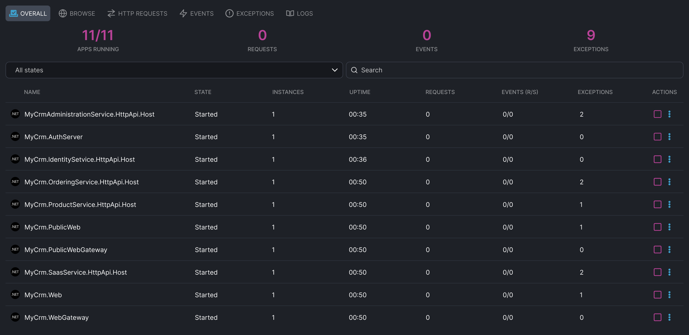
ABP Studio: Why?
A single UI to control multi-application solutions
Running multiple applications/services with a single click
Browse, monitor, trace and debug problems across applications/services

Slide 6
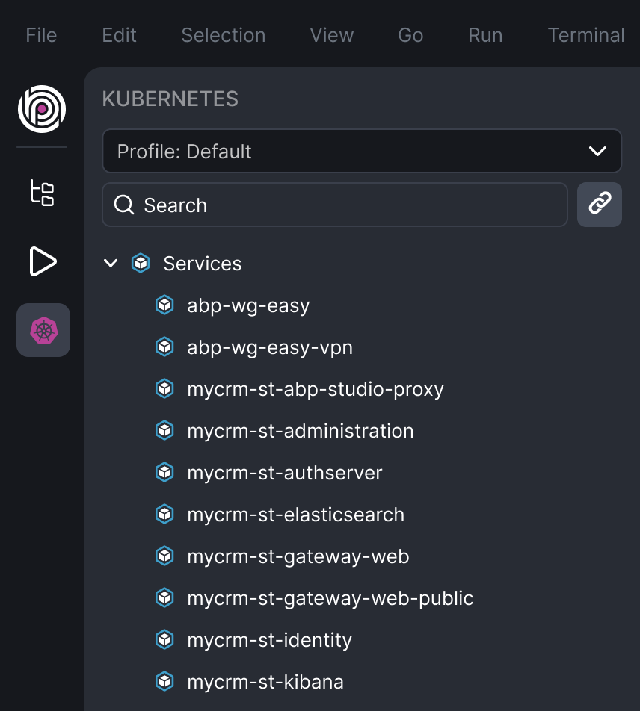
ABP Studio: Why?
A comfortable development environment for Kubernetes
Seemlessly integrate your local environment to a Kubernetes cluster
Access internal services
Intercept traffic to run, debug and develop a service in your local environment

Slide 7
DEMO

Slide 8



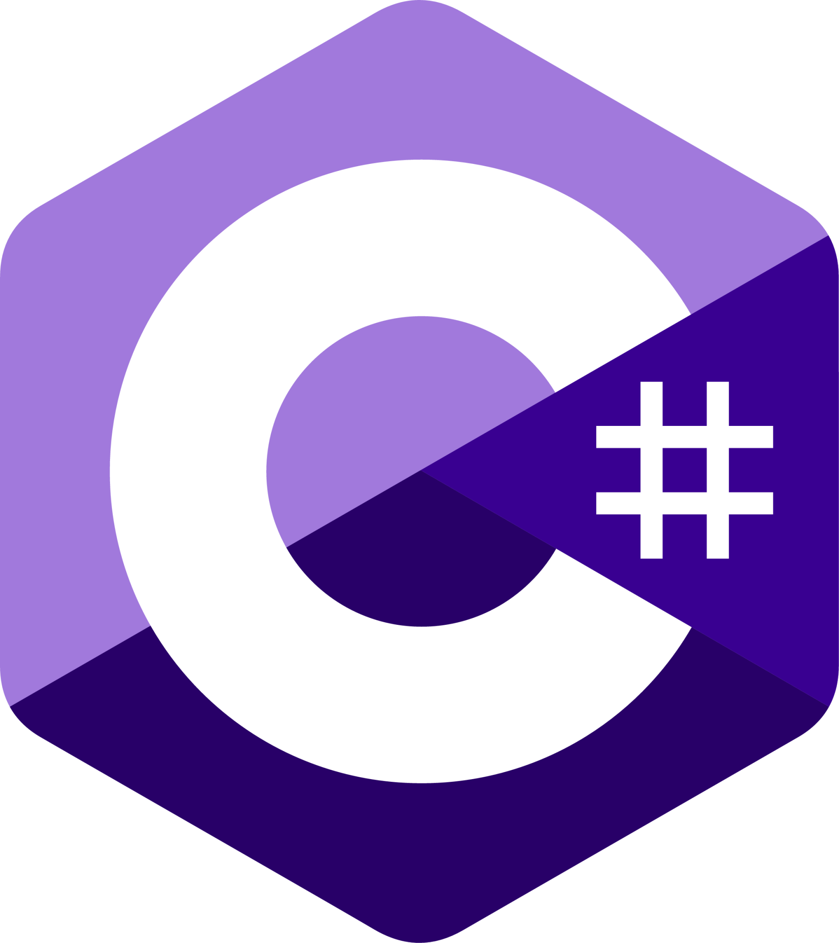

ABP Studio Main Solution Components
EasyCrm.OrderingService .NET Solution
EasyCrm.OrderingService ABP Studio Module
EasyCrm.BasketService .NET Solution
EasyCrm.BasketService ABP Studio Module
EasyCrm.CatalogService .NET Solution
EasyCrm
ABP Studio Solution
EasyCrm.CatalogService ABP Studio Module
EasyCrm.CustomerService .NET Solution
EasyCrm.CustomersService ABP Studio Module
EasyCrm.CustomerService.UI .NET Project (.csproj)
EasyCrm.CustomerService.UI ABP Studio Package

Slide 9
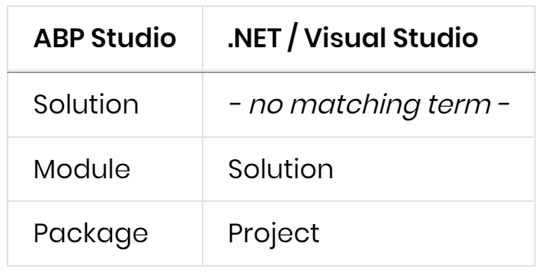
ABP Studio Main Solution Components

Slide 10
ABP Studio vs .NET Aspire
Feature | ABP Studio | .NET Aspire
Integration Packages (Dapr, Redis, RabbitMQ, MongoDB, etc) | YES (rich and well-integrated abstractions) / ABP Framework | YES (simple abstraction and integrations)
Starter Templates | YES (avdanced architecture & options) | YES (simple)
Monitoring | HTTP Requests, Events, Exceptions, Logs | Metrics, Traces, Logs
Architecting / Building Solutions | YES | -
Application Runner | YES | -
Kubernetes Tunneling | YES | -
Building Modular Solutions | YES | -

Slide 11
ABP Studio: Road Map
UI Theme Builder
Customizing Re-used Application Modules
Internal & Public Module Stores
More Deployment Options
Analyzing Your Solution & Smart Best-Practice Suggestions
Rapid Application Development System
Any feature request: info@abp.io

Slide 12
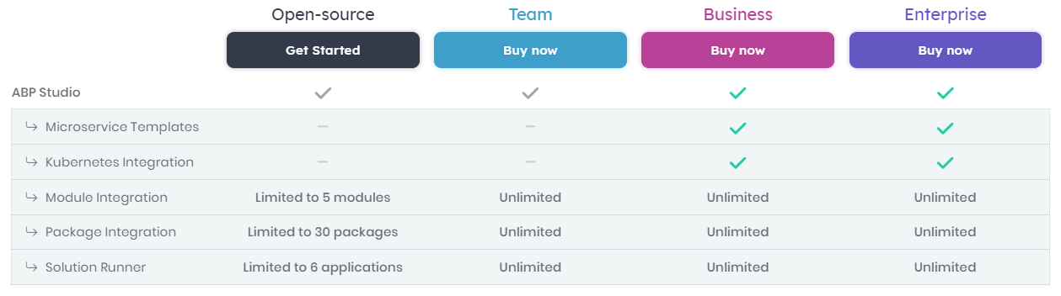
ABP Studio: Licensing

Slide 13
ABP Studio: Next Planned Live Events
Developing Modular Monolith Applications
Developing Microservice Applications & The Microservice Startup Template

Slide 14
? questions

Slide 15
Topic title
Content

